Slide 1




Airborne laser scanning mission simulation and planning for the Velodyne PUCK™
H. Andrew Lassiter PhD Candidate, Geomatics
2018 ASPRS Annual Conference Denver, CO · 7 February 2018

Slide 2
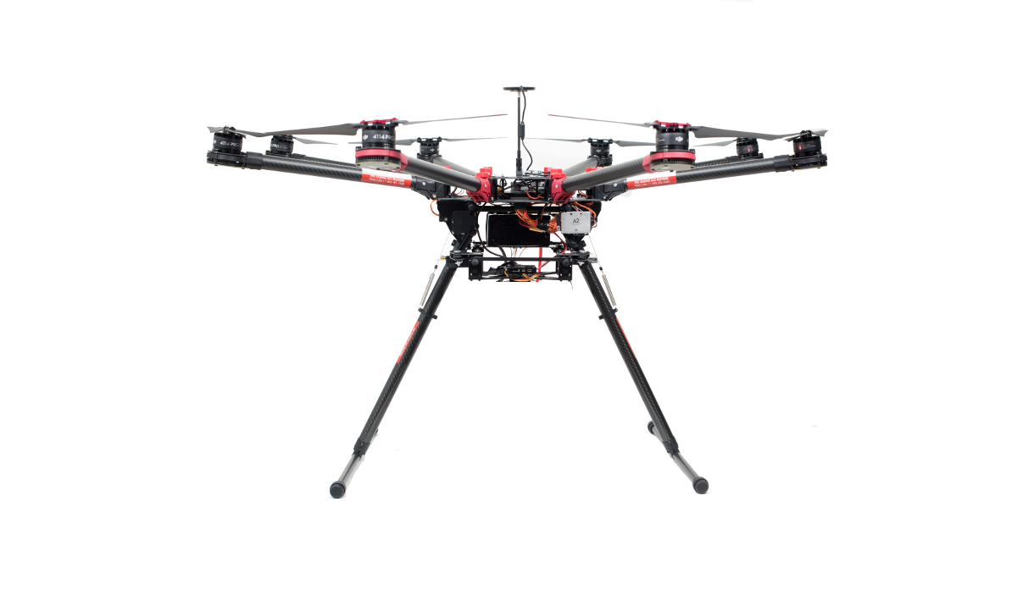
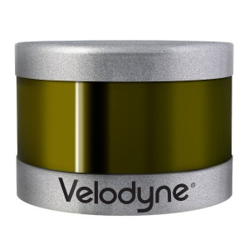
Designed with mapping in mind?
VLP-16’s “fan” of lasers originally designed for self-driving cars
When mounted to look down instead of horizontal, especially at low AGL, a peculiar scan pattern results
This “fan” emitter-detector configuration is becoming more prevalent; it is imperative that we understand it and plan missions accordingly
z_{puck}
Velodyne VLP-16 PUCK™
30° “vertical” FOV across 16 channels (2° spacing)
360° “horizontal” FOV at 5-20 Hz rotation rate
300,000 Hz sample rate
Range 100 m (reported), 120 m (empirical)
-15°
15°

Slide 3
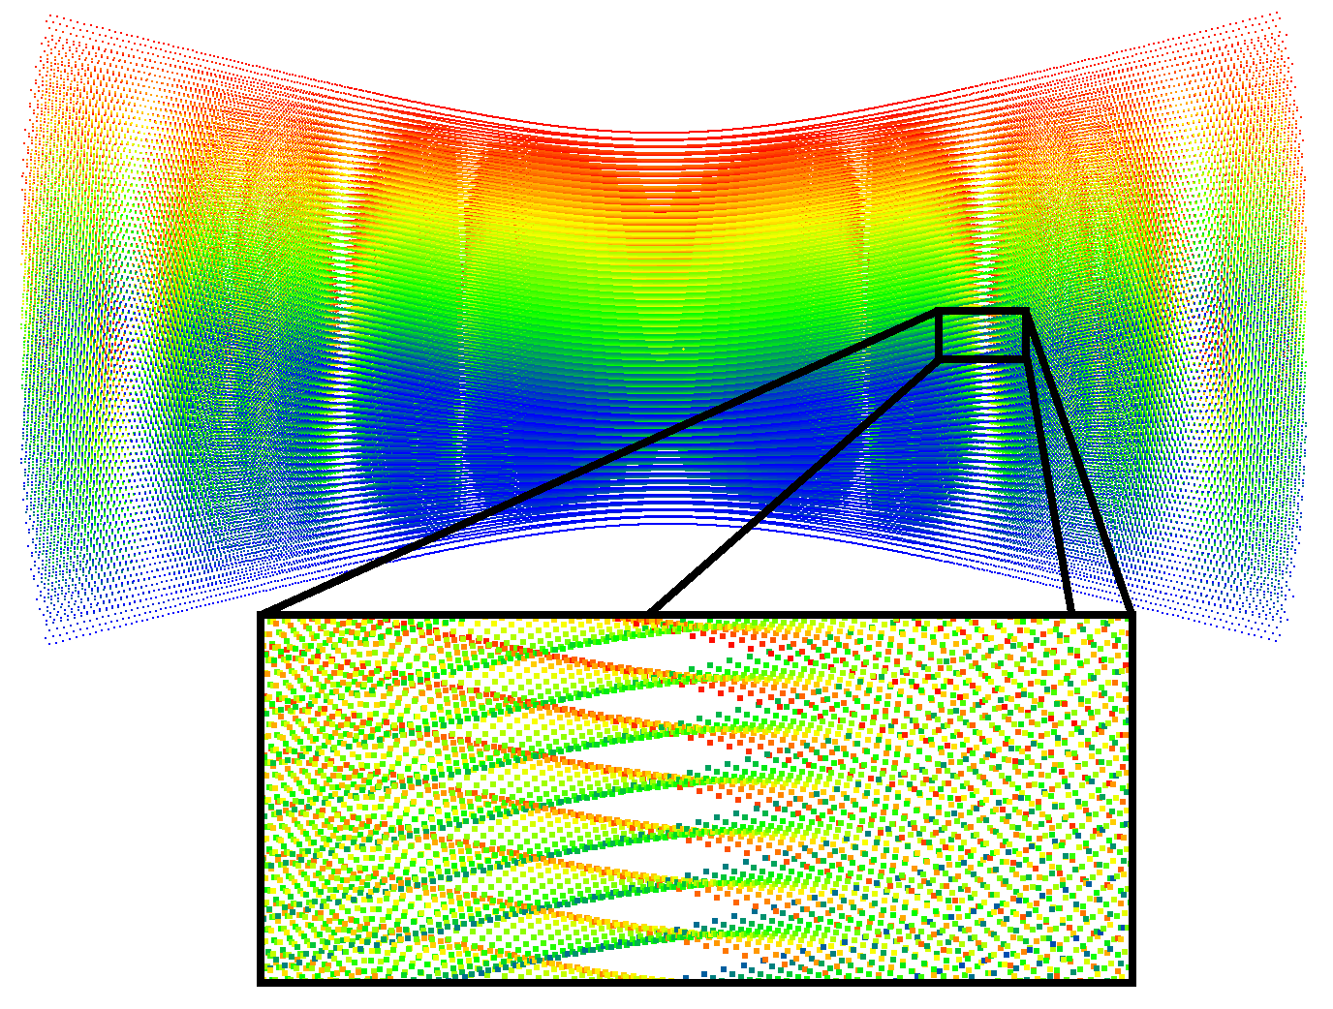
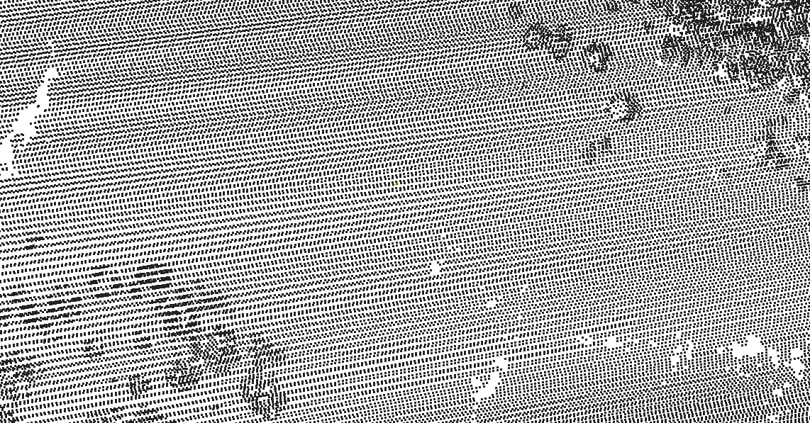
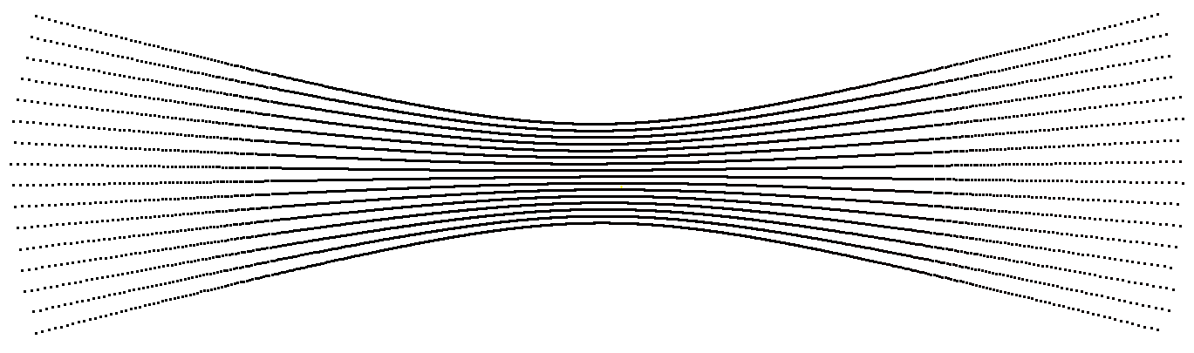
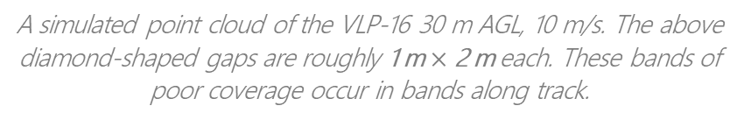
“Pointillated affine hyperbolae”
Line scanner at 500 m AGL (top) versus VLP-16 (single pass, 30 m AGL).
A simulated point cloud of the VLP-16 30 m AGL, 10 m/s. The above diamond-shaped gaps are roughly 1 m $×$ 2 m each. These bands of poor coverage occur in bands along track.

Slide 4
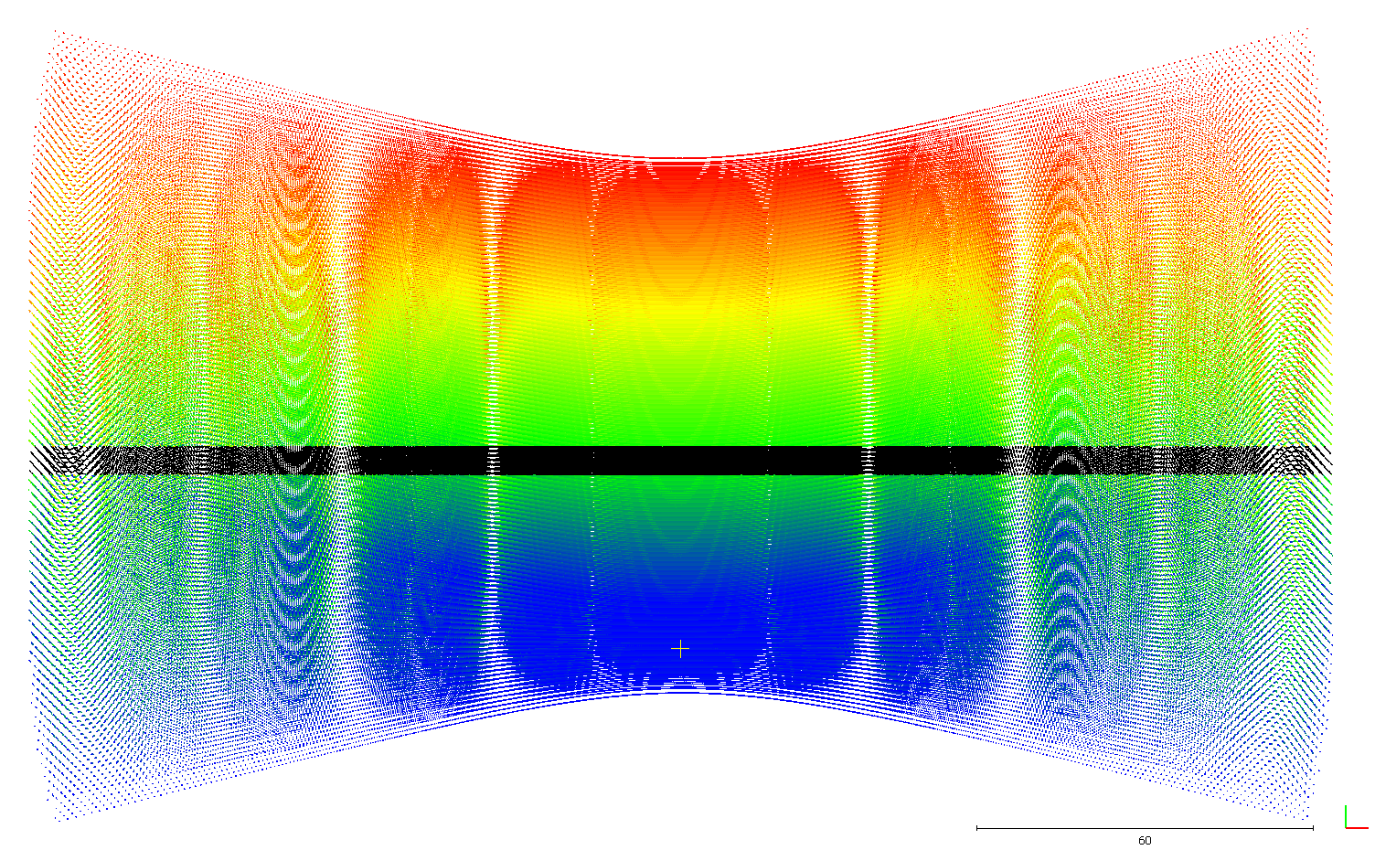
puckSim(): scanning simulation
Developed software (MATLAB) to simulate flights with the VLP-16 to detect the gaps and to help eliminate them in a mission by:
Adjusting flight parameters (speed, height)
Increasing or decreasing flight line spacing
Adjusting orientation of the scanner w/r/t flight line
“fully illuminated” profile

Slide 5
puckSim()
puckSim(height, % flying height
speed, % forward speed
rotationRate, % rotation rate of scanner head
tilt, % tilt of scanner
yaw, % yaw of scanner
maxRange, % discard returns > maxRange
profile) % profile
puckSim() output (ASCII file)
X Y Z azimuth vert_angle time Tx Ty Tz range dirx diry dirz
26.189 31.772 0.000 0.41156133 0.05235988 4.723550202 0.000 28.341 60.000 65.556 0.399 0.052 -0.915
26.438 31.778 0.000 0.41503568 0.05235988 4.723605498 0.000 28.342 60.000 65.656 0.403 0.052 -0.914
26.687 31.783 0.000 0.41851003 0.05235988 4.723660794 0.000 28.342 60.000 65.758 0.406 0.052 -0.912
26.937 31.789 0.000 0.42198438 0.05235988 4.723716090 0.000 28.342 60.000 65.860 0.409 0.052 -0.911
27.188 31.795 -0.000 0.42545873 0.05235988 4.723771386 0.000 28.343 60.000 65.963 0.412 0.052 -0.910
27.440 31.801 0.000 0.42893308 0.05235988 4.723826682 0.000 28.343 60.000 66.067 0.415 0.052 -0.908
27.692 31.807 0.000 0.43240743 0.05235988 4.723881978 0.000 28.343 60.000 66.173 0.418 0.052 -0.907
27.946 31.812 0.000 0.43588178 0.05235988 4.723937274 0.000 28.344 60.000 66.280 0.422 0.052 -0.905
28.200 31.818 0.000 0.43935613 0.05235988 4.723992570 0.000 28.344 60.000 66.387 0.425 0.052 -0.904
28.455 31.824 0.000 0.44283048 0.05235988 4.724047866 0.000 28.344 60.000 66.496 0.428 0.052 -0.902
28.710 31.831 0.000 0.44630483 0.05235988 4.724103162 0.000 28.345 60.000 66.607 0.431 0.052 -0.901
28.967 31.837 0.000 0.44977918 0.05235988 4.724158458 0.000 28.345 60.000 66.718 0.434 0.052 -0.899
29.224 31.843 0.000 0.45325353 0.05235988 4.724213754 0.000 28.345 60.000 66.830 0.437 0.052 -0.898
29.483 31.849 -0.000 0.45672788 0.05235988 4.724269050 0.000 28.346 60.000 66.944 0.440 0.052 -0.896

Slide 6
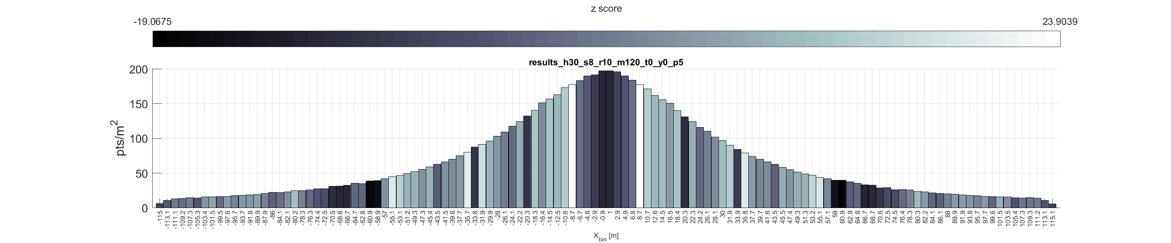
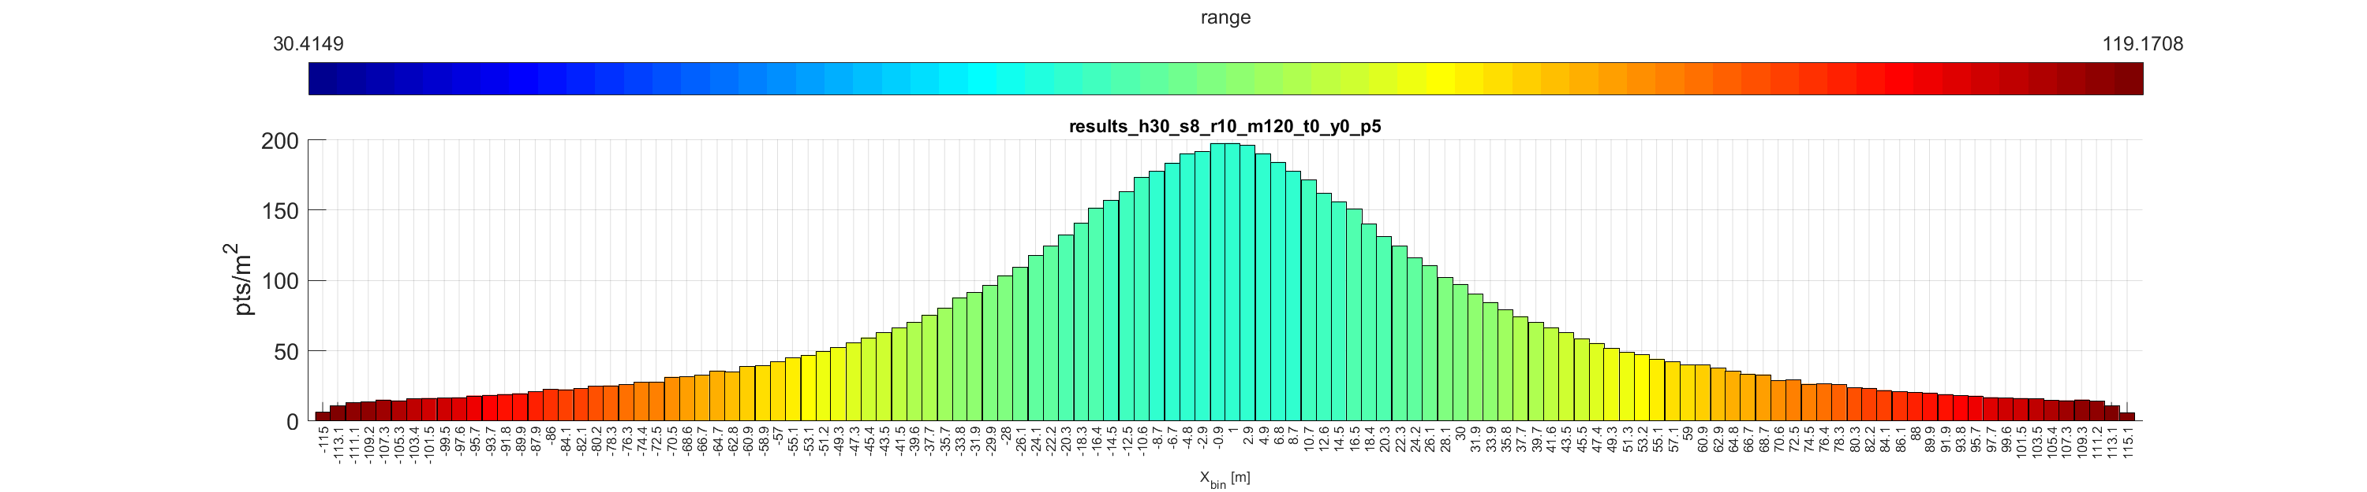
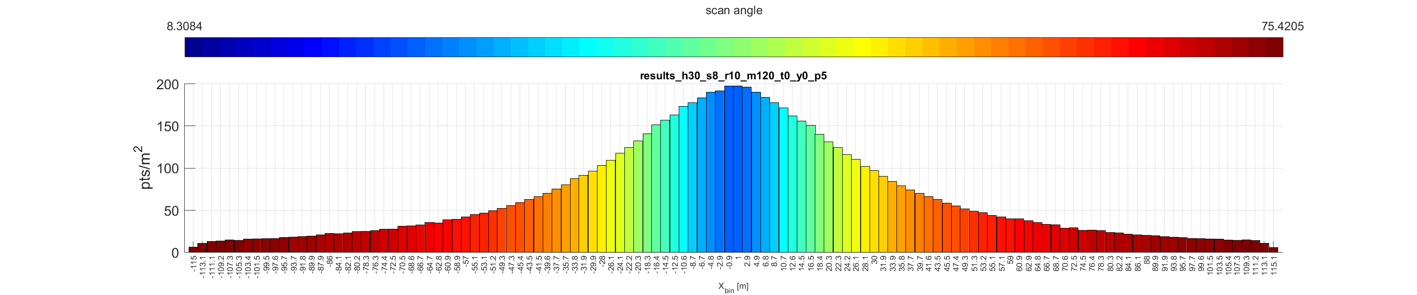
puckStats(): spatial analysis
Across-track profile from puckSim() divided into equal-area bins
For each bin:
Nearest neighbor index^{[1]} (low:clustering::high:dispersion)
Average range of returns
Average scan angle of returns

Slide 7
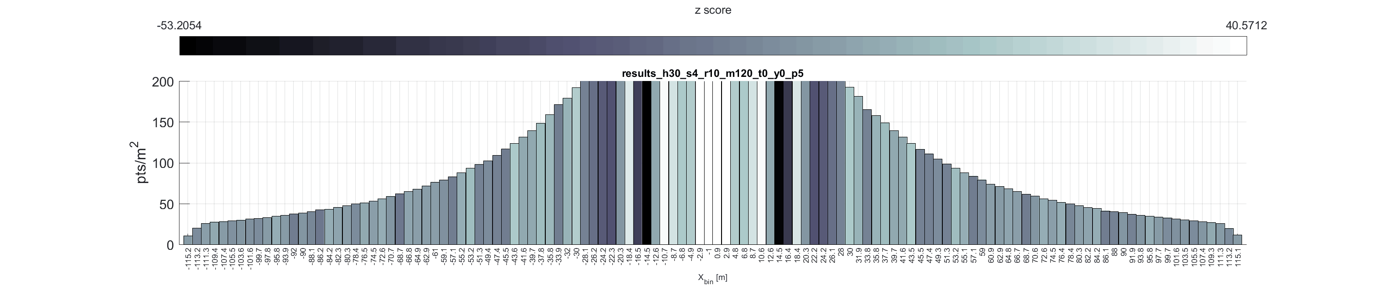
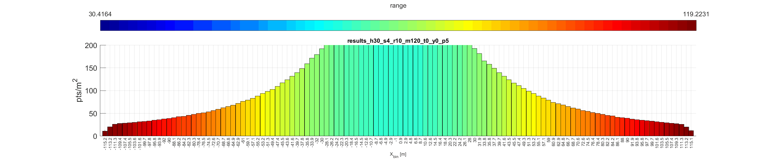
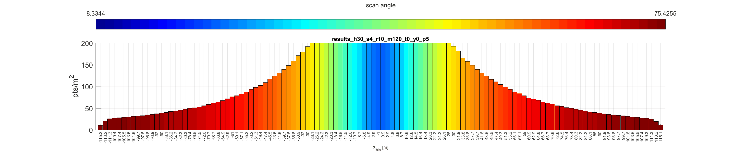
NN z-score black = clustered
white = dispersed
h30 = 30 m AGL
s4 = 4 m/s forward speed
Range average range of all returns within each bin
Scan angle average scan angle of all returns within each bin
Non-GIF results for NN z-score in Appendix [2]

Slide 8
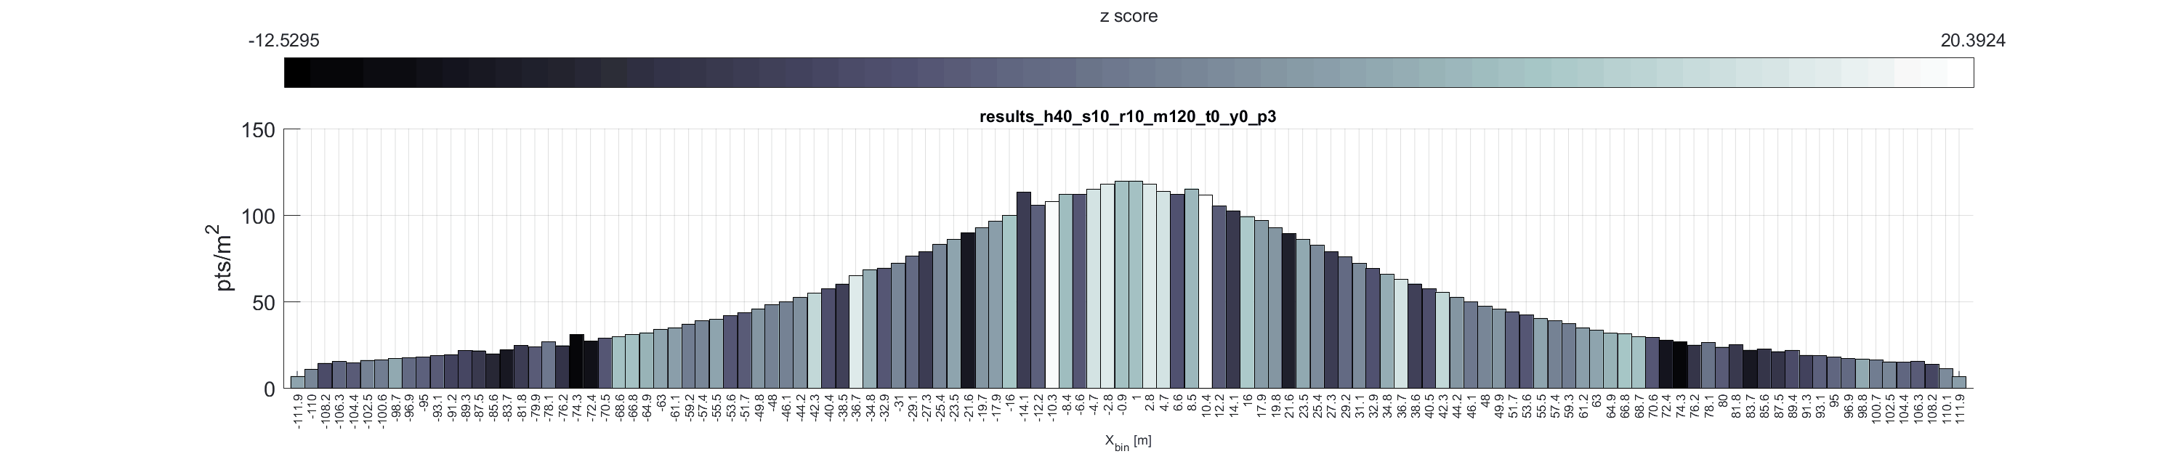
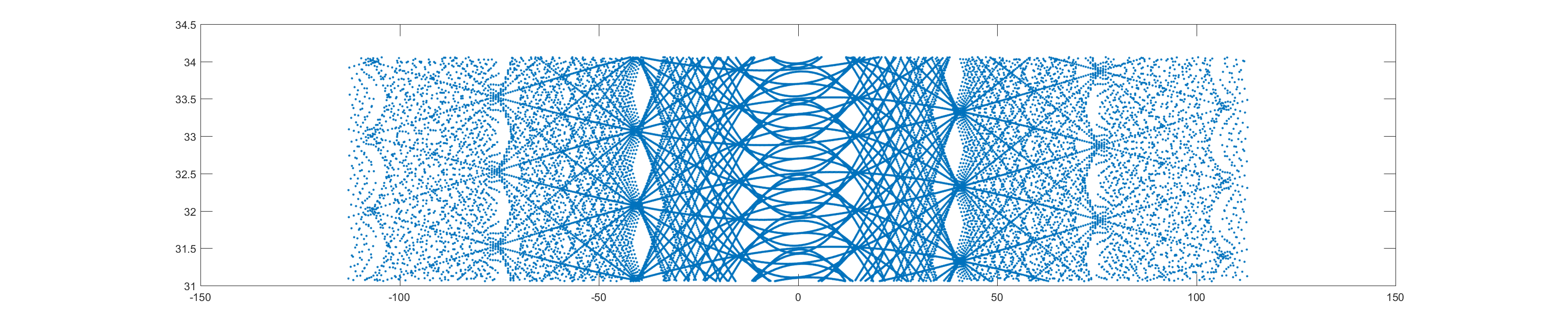
Exaggerated in y to show detail
Is there a pattern in gap location w/r/t forward speed? Maybe... (Non-GIF in Appendix [3])

Slide 9
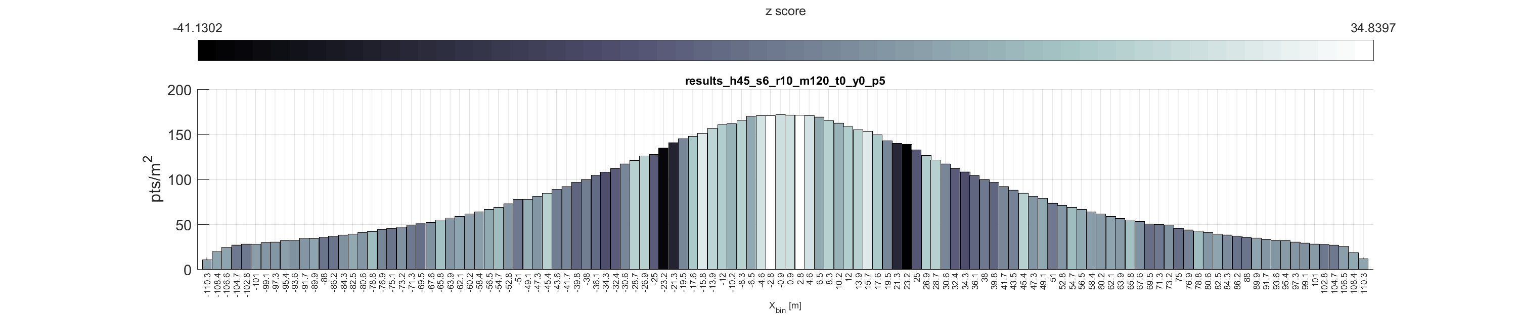
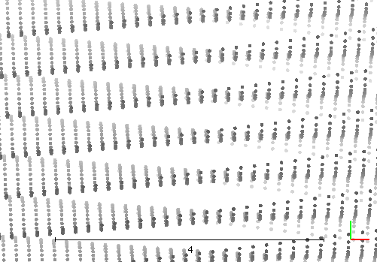
Mission planning: filling in the gaps
Are the gaps large enough to cause an issue?
e.g. corridor surveys, small objects of interest
Fill with overlap: so long as gap bands do not overlap, then gaps will be filled
For this example, 45- to 50-m flight line spacing would cause gaps to overlap
45 m AGL, 6 m/s ~4-m-wide gaps at 23 m from nadir

Slide 10
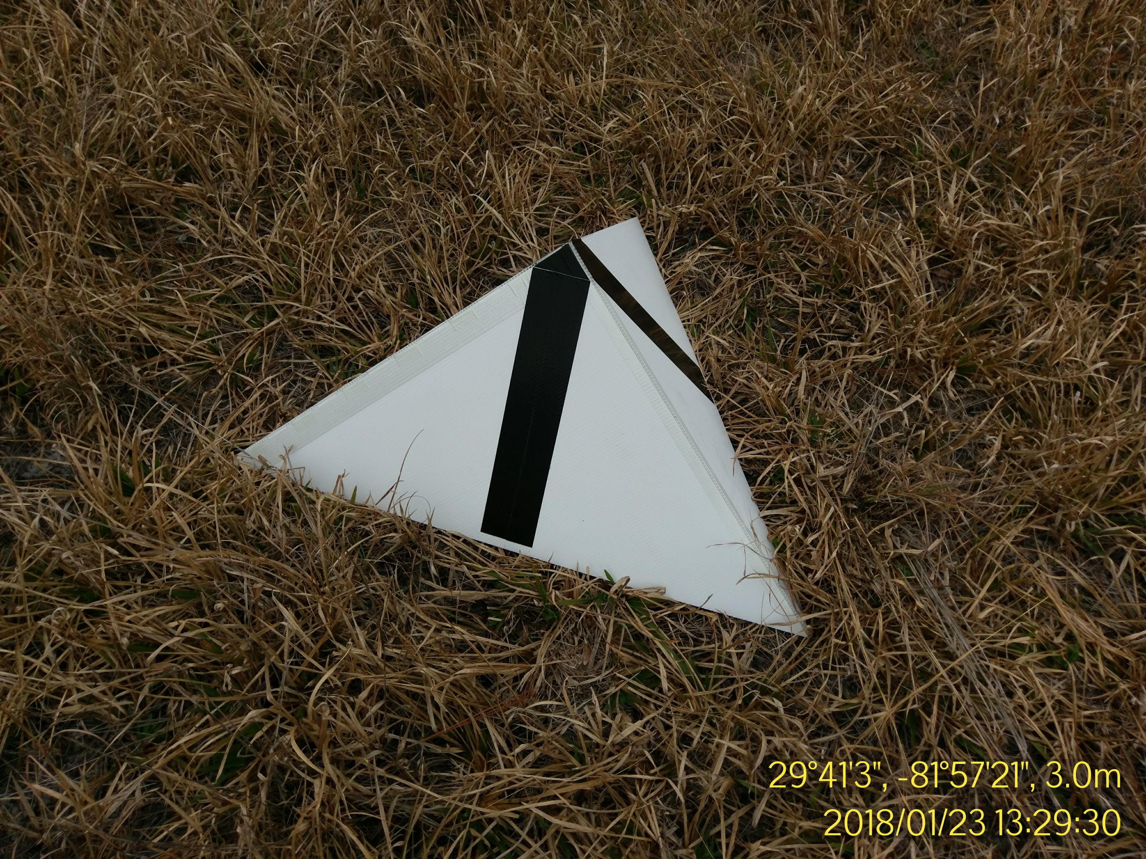

Re: small areas of interest
Collapsible pyramids designed for this project. Can be used for BS/LA calibration accuracy assessment and as checkpoints
1.1 m

Slide 11
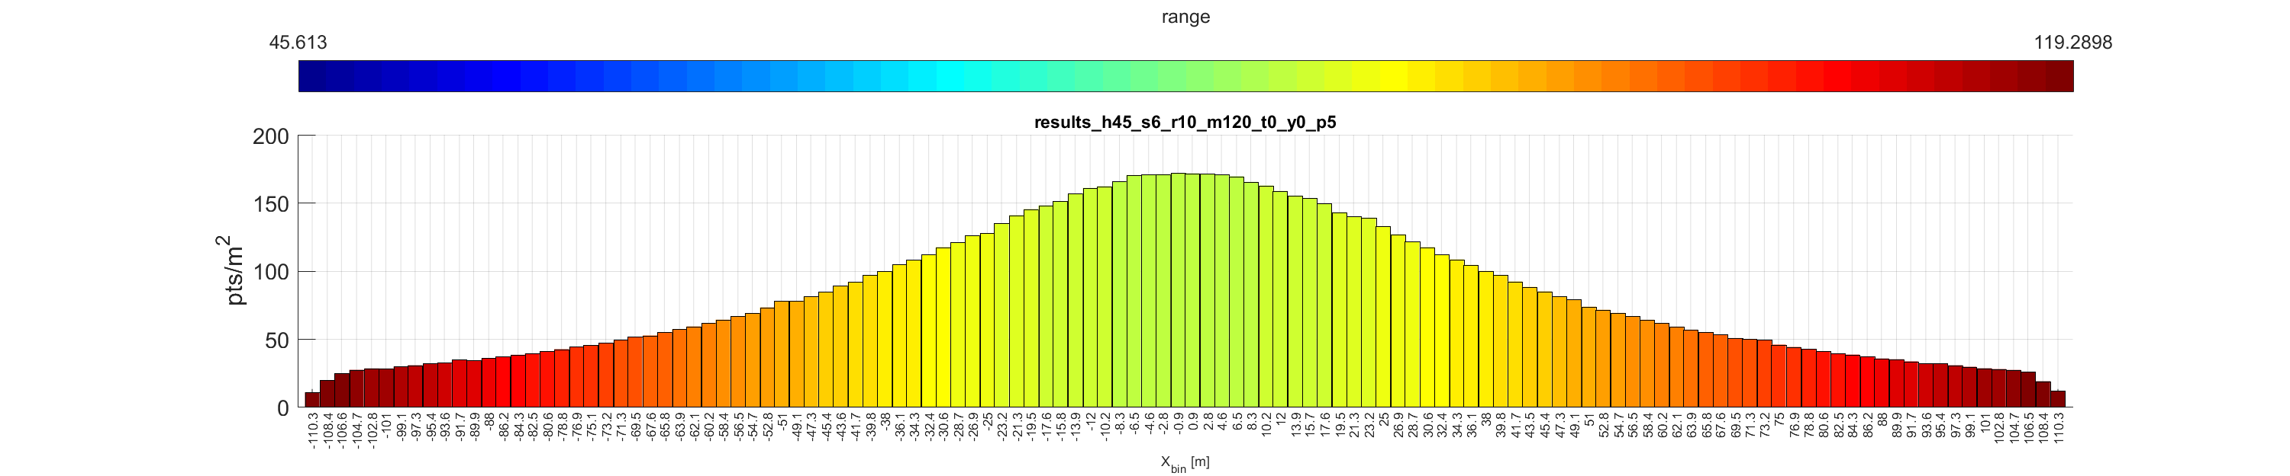
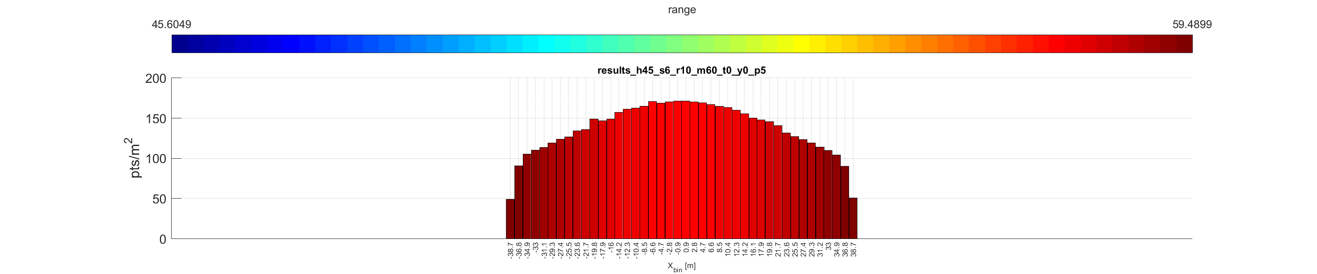
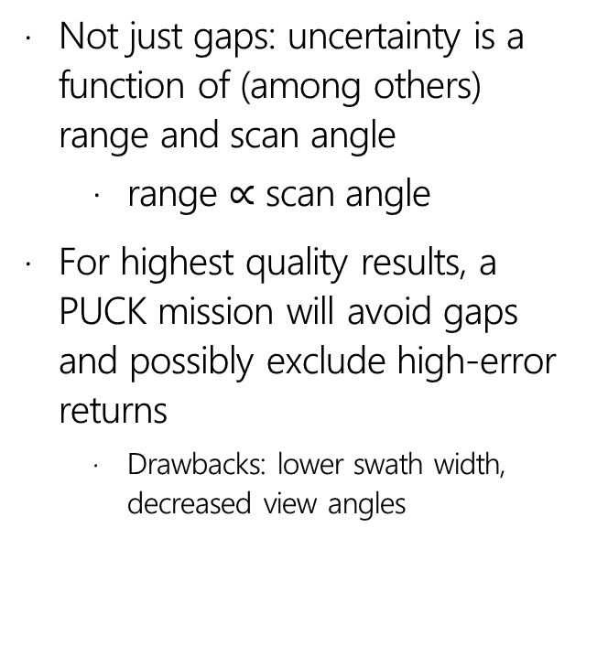
Mission planning: less is more
Not just gaps: uncertainty is a function of (among others) range and scan angle
range $∝$ scan angle
For highest quality results, a PUCK mission will avoid gaps and possibly exclude high-error returns
Drawbacks: lower swath width, decreased view angles

Slide 12
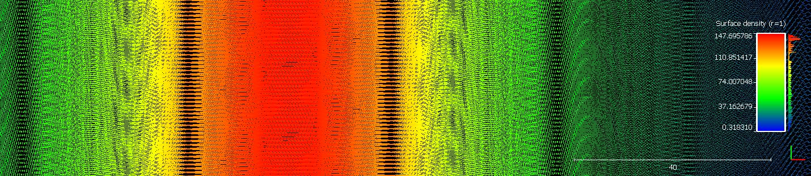
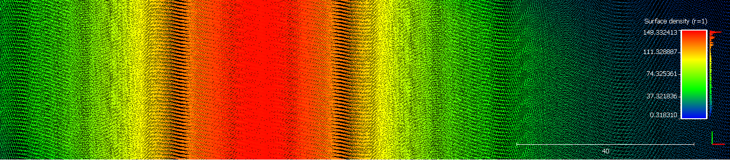
Mission planning: just add yaw
0° yaw (top) and 10° yaw (bottom). Adding yaw makes the gaps narrower and longer. Effect on swath width is minimal: cos(yaw)

Slide 13
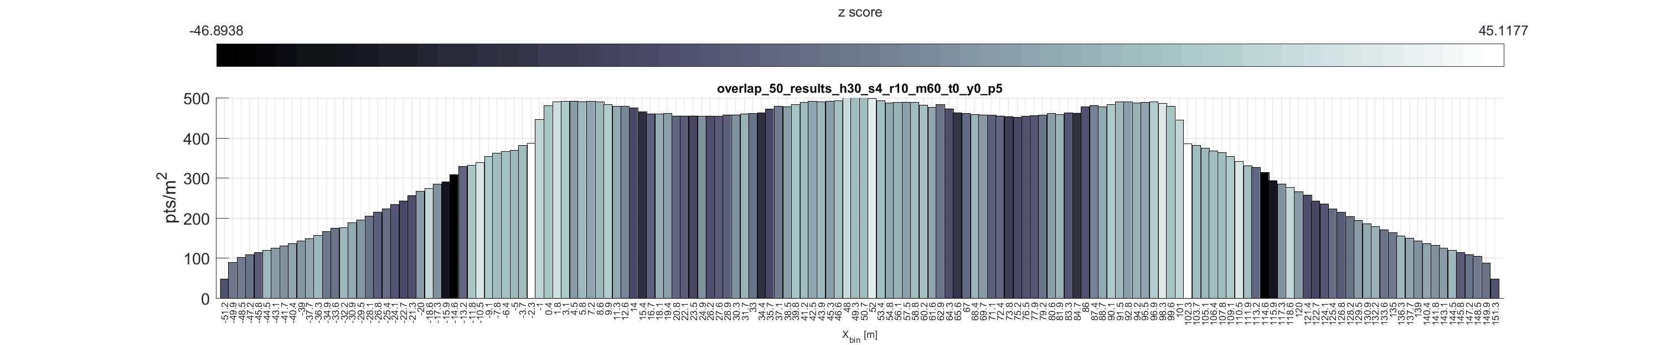
Overlap & point density
Maximum overlap of swaths
Software will also simulate three parallel flight lines, which can be analyzed by NN index, avg range, and avg scan angle with puckStats(). (Non-GIF results in Appendix [4])

Slide 14
Airborne laser scanning mission simulation and planning for the Velodyne PUCK™
H. Andrew Lassiter PhD Candidate, Geomatics
2018 ASPRS Annual Conference Denver, CO · 7 February 2018

Slide 15

Appendix

Slide 16
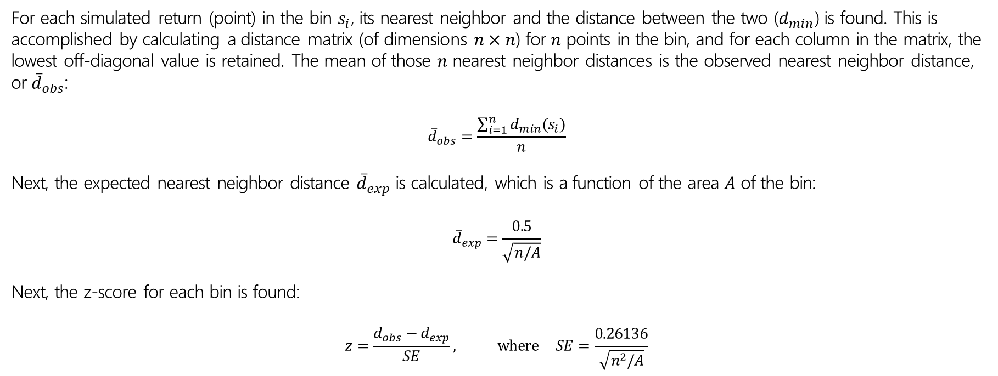
^{[1]} Nearest neighbor index
For each simulated return (point) in the bin $s_{i}$, its nearest neighbor and the distance between the two ($d_{min}$) is found. This is accomplished by calculating a distance matrix (of dimensions $n×n$) for $n$ points in the bin, and for each column in the matrix, the lowest off-diagonal value is retained. The mean of those $n$ nearest neighbor distances is the observed nearest neighbor distance, or ${\overline{d}}_{obs}$:
$${\overline{d}}_{obs}=\frac{\sum_{i=1}^{n}{d_{min}(s_{i})}}{n}$$
Next, the expected nearest neighbor distance ${\overline{d}}_{exp}$ is calculated, which is a function of the area $A$ of the bin:
$${\overline{d}}_{exp}=\frac{0.5}{\sqrt{n/A}}$$
Next, the z-score for each bin is found:
$$z=\frac{d_{obs}−d_{exp}}{SE}, where SE=\frac{0.26136}{\sqrt{n^{2}/A}}$$

Slide 17
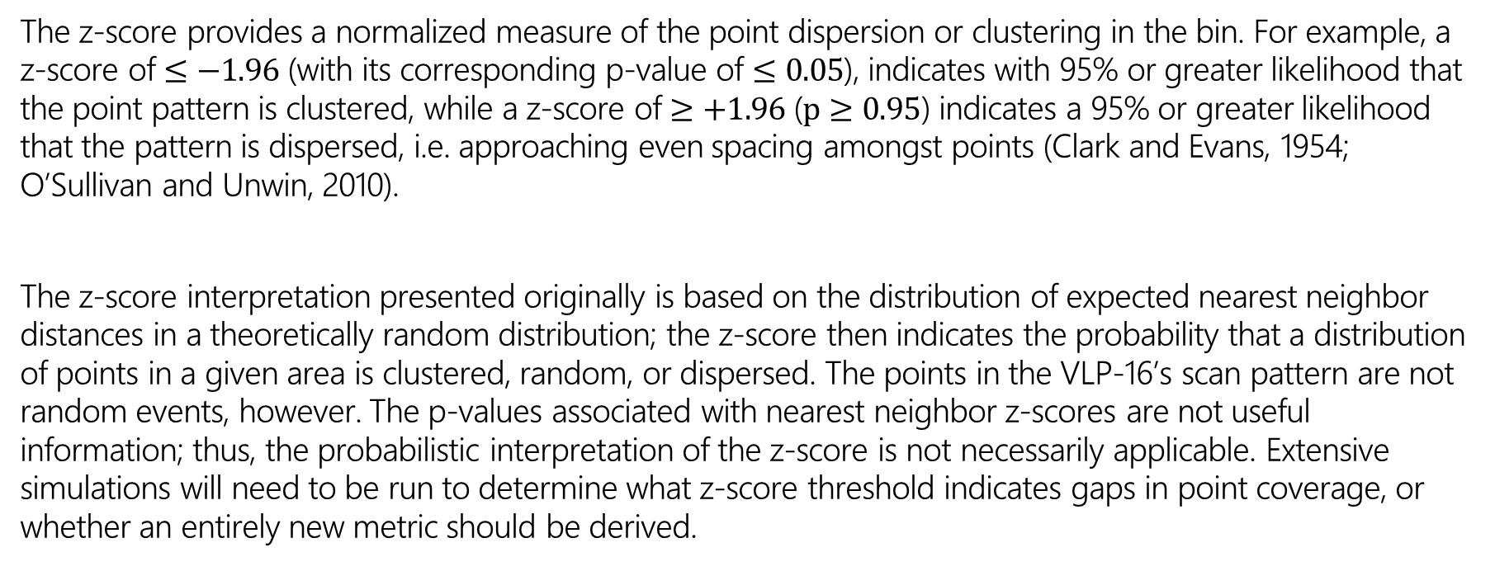
^{[1]} Nearest neighbor index
The z-score provides a normalized measure of the point dispersion or clustering in the bin. For example, a z-score of $≤−1.96$ (with its corresponding p-value of $≤0.05$), indicates with 95% or greater likelihood that the point pattern is clustered, while a z-score of $≥+1.96$ ($p≥0.95$) indicates a 95% or greater likelihood that the pattern is dispersed, i.e. approaching even spacing amongst points (Clark and Evans, 1954; O’Sullivan and Unwin, 2010).
The z-score interpretation presented originally is based on the distribution of expected nearest neighbor distances in a theoretically random distribution; the z-score then indicates the probability that a distribution of points in a given area is clustered, random, or dispersed. The points in the VLP-16’s scan pattern are not random events, however. The p-values associated with nearest neighbor z-scores are not useful information; thus, the probabilistic interpretation of the z-score is not necessarily applicable. Extensive simulations will need to be run to determine what z-score threshold indicates gaps in point coverage, or whether an entirely new metric should be derived.

Slide 18
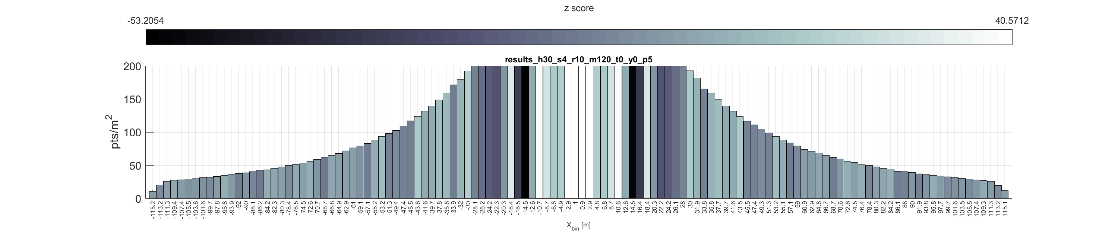
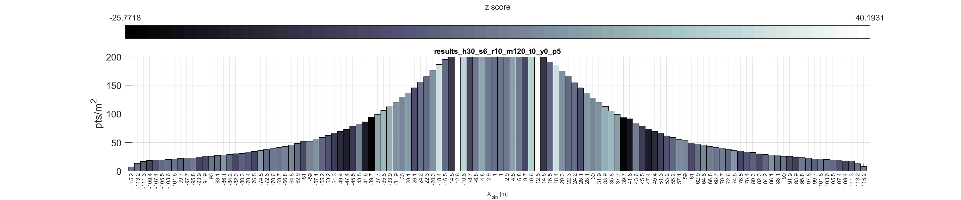
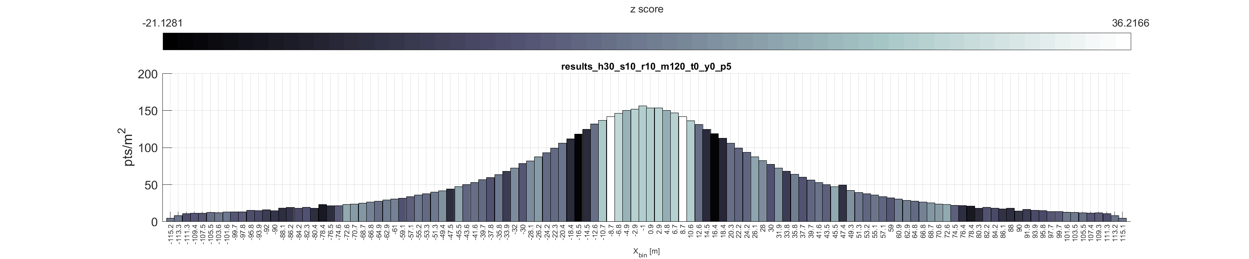
^{[2]} Results
Nearest neighbor index at flying height of 30 m and forward speeds of 4 m/s (top left), 6 m/s (bottom left), 8 m/s (top right), 10 m/s (bottom right)

Slide 19
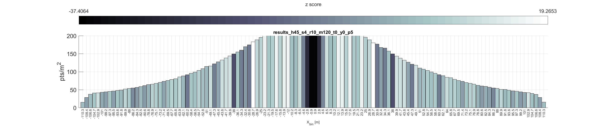
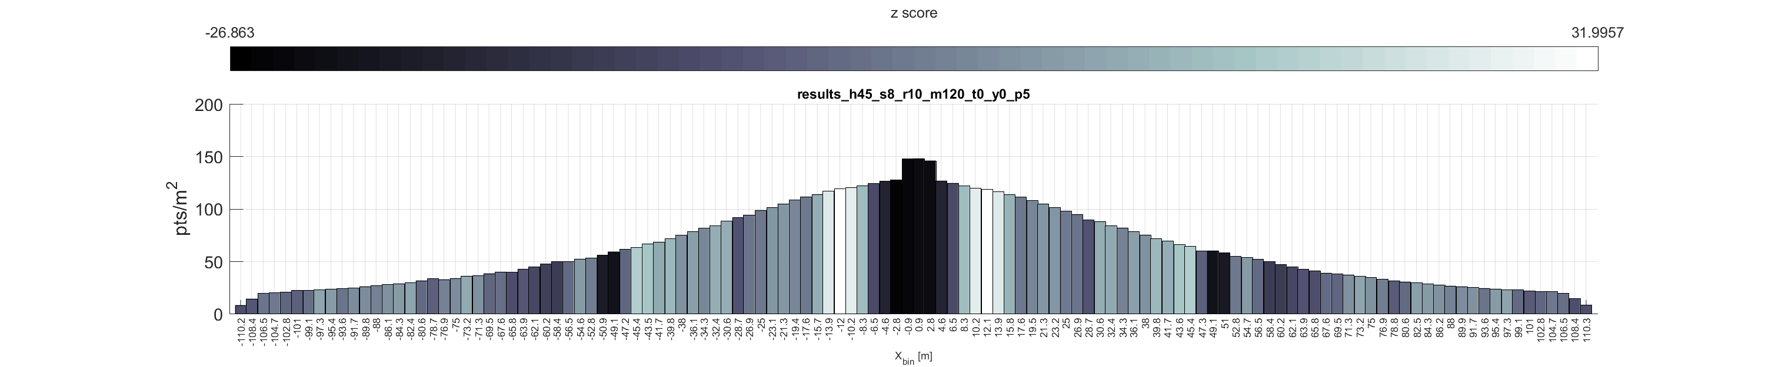
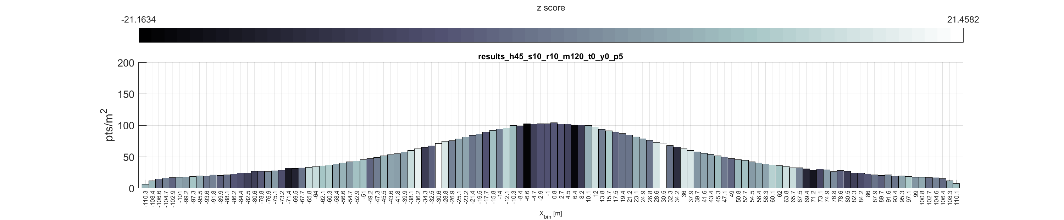
^{[2]} Results
Nearest neighbor index at flying height of 45 m and forward speeds of 4 m/s (top left), 6 m/s (bottom left), 8 m/s (top right), 10 m/s (bottom right)

Slide 20
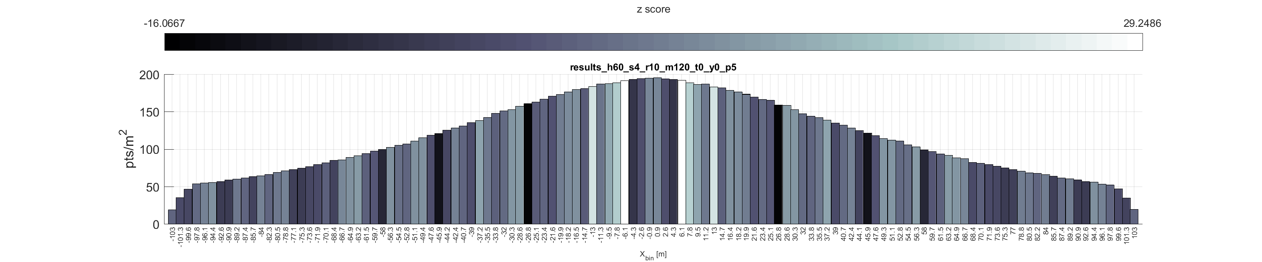
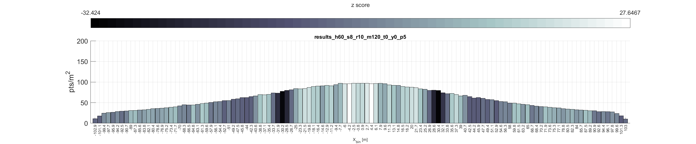
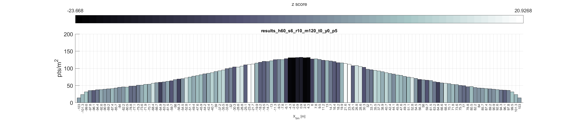
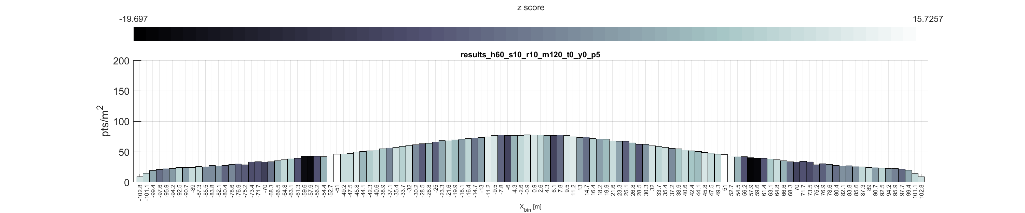
^{[2]} Results
Nearest neighbor index at flying height of 60 m and forward speeds of 4 m/s (top left), 6 m/s (bottom left), 8 m/s (top right), 10 m/s (bottom right)

Slide 21

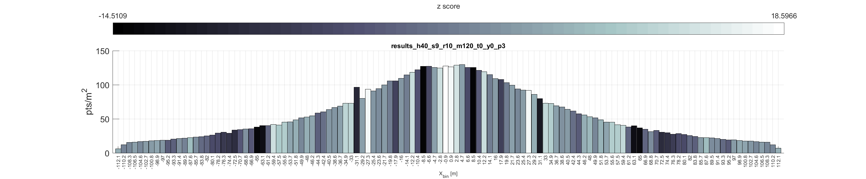
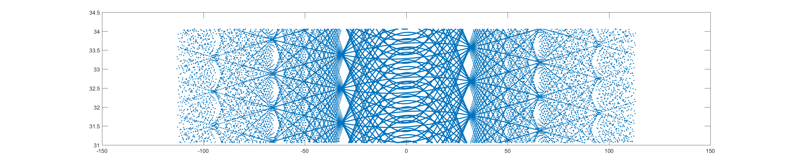
^{[3]} Results
Nearest neighbor index (top) and scan pattern (bottom) at flying height of 40 m and forward speeds of 10 m/s (left) and 9 m/s (right). Scan pattern exaggerated in y to show detail.

Slide 22
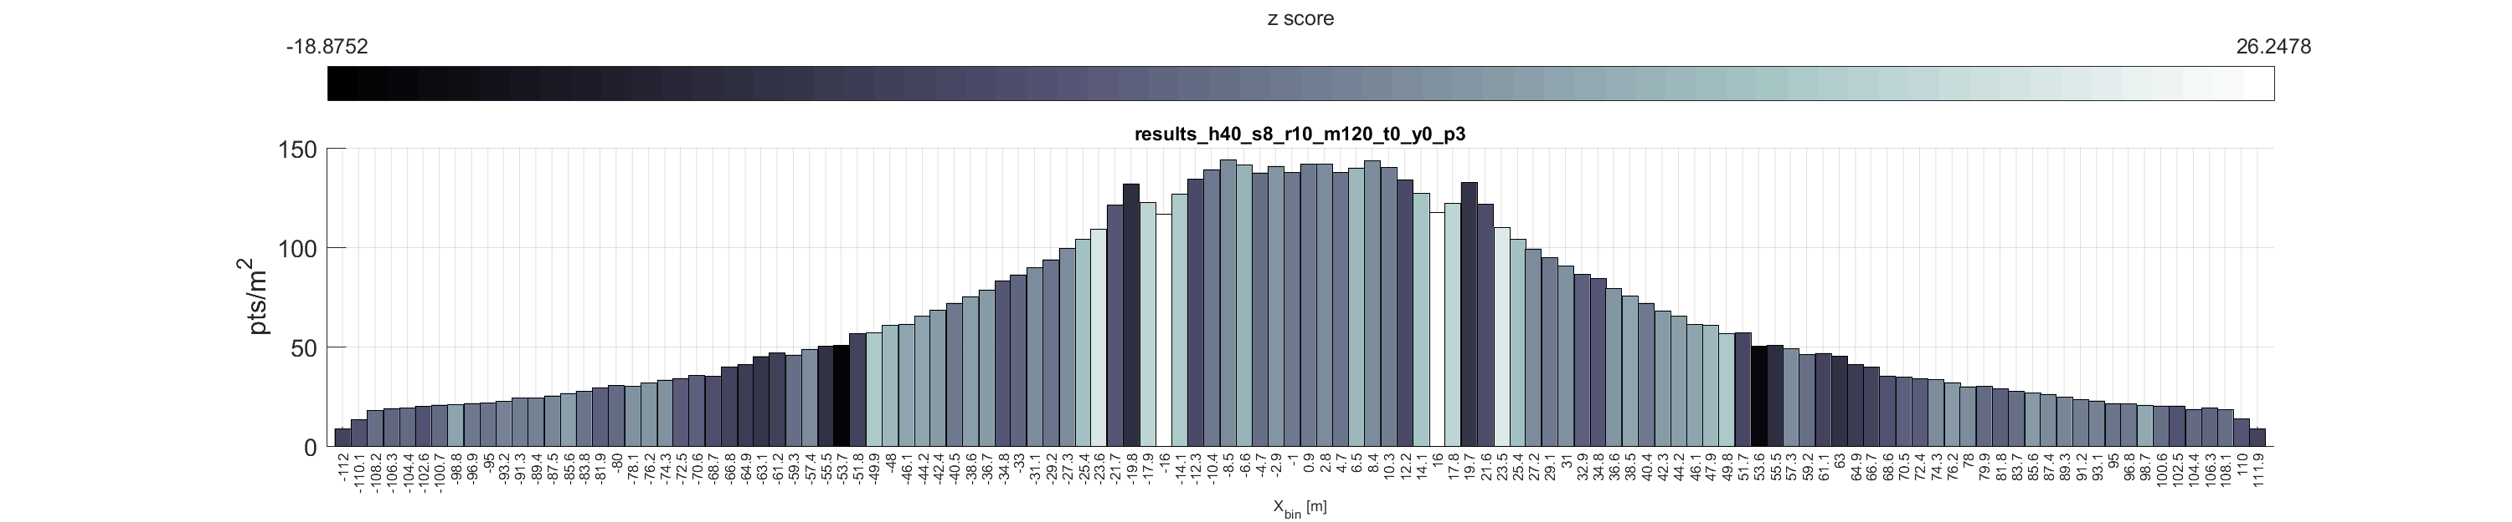
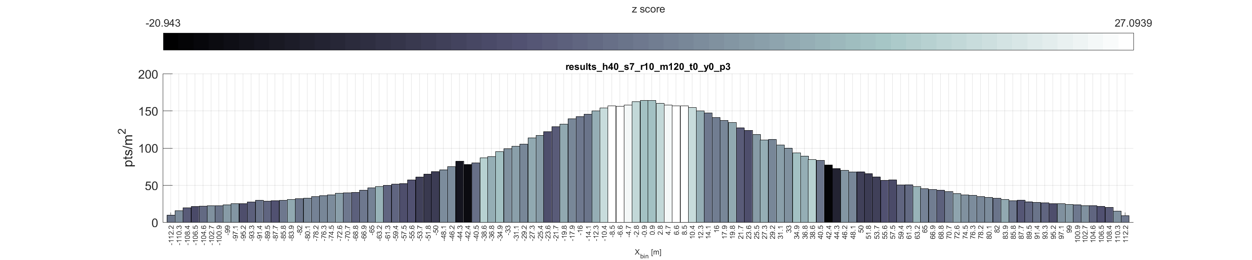
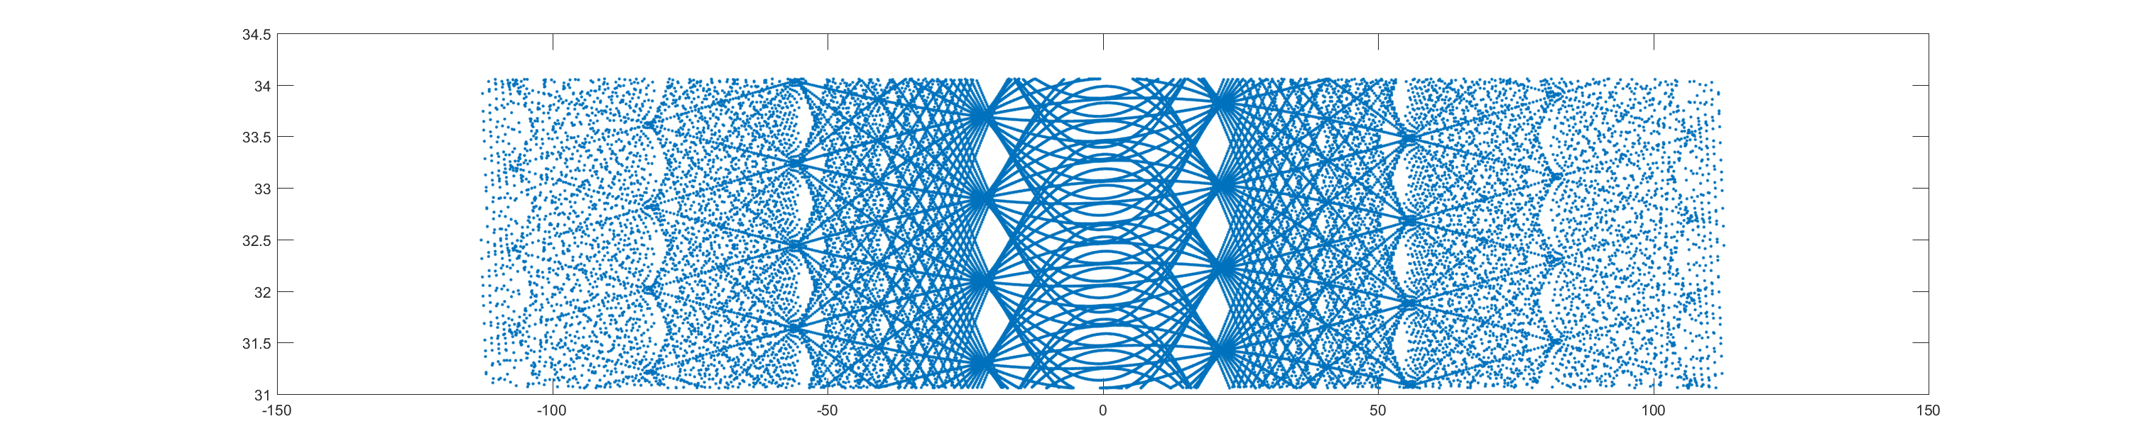
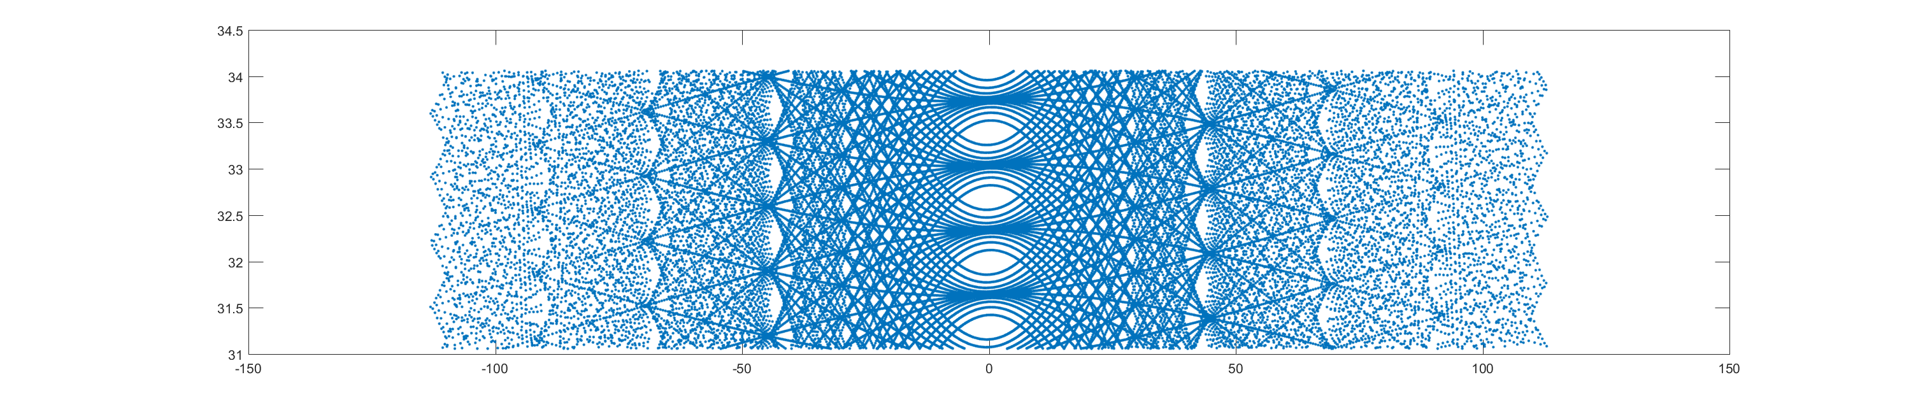
^{[3]} Results
Nearest neighbor index (top) and scan pattern (bottom) at flying height of 40 m and forward speeds of 8 m/s (left) and 7 m/s (right). Scan pattern exaggerated in y to show detail.

Slide 23
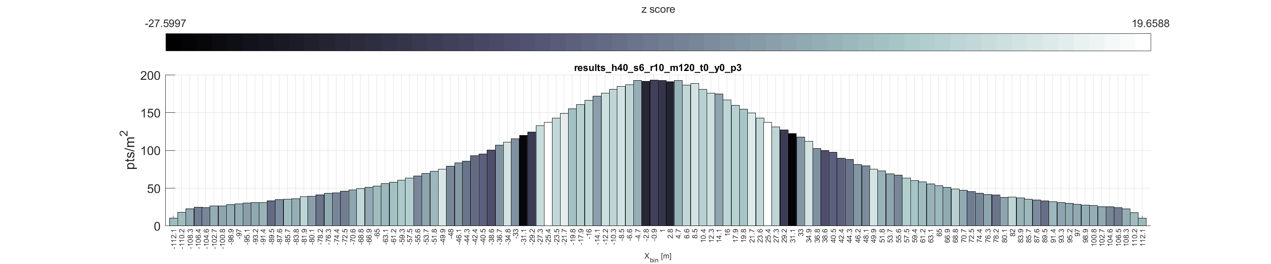
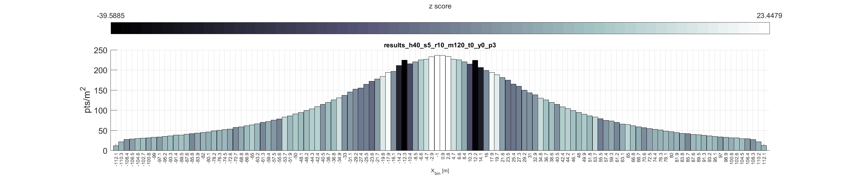
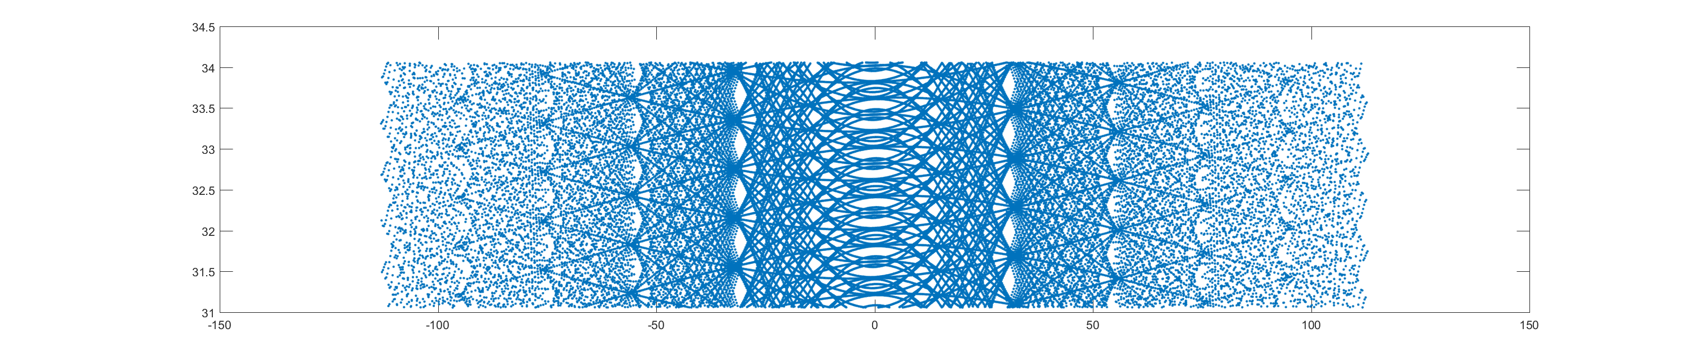
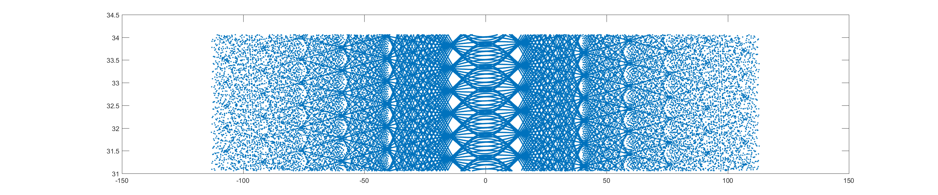
^{[3]} Results
Nearest neighbor index (top) and scan pattern (bottom) at flying height of 40 m and forward speeds of 6 m/s (left) and 5 m/s (right). Scan pattern exaggerated in y to show detail.

Slide 24
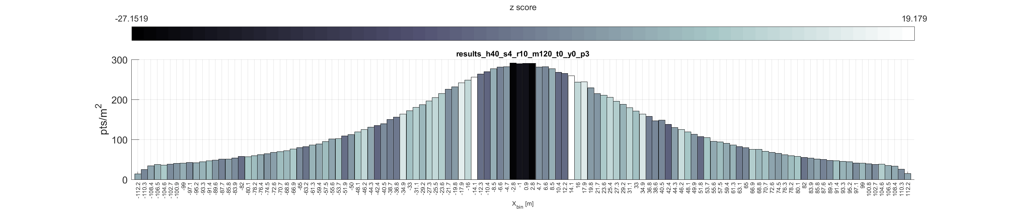
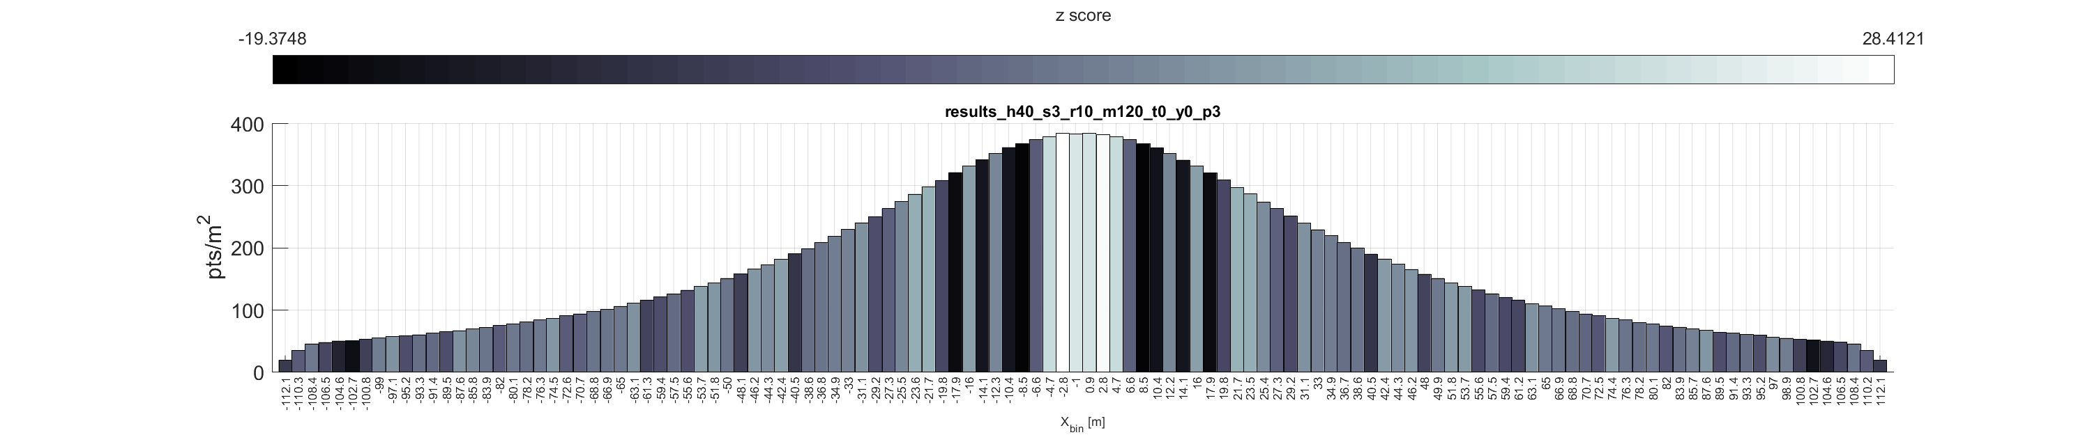
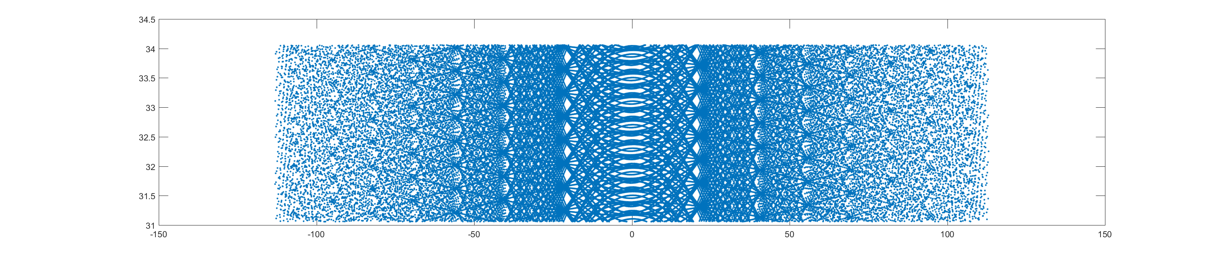

^{[3]} Results
Nearest neighbor index (top) and scan pattern (bottom) at flying height of 40 m and forward speeds of 4 m/s (left) and 3 m/s (right). Scan pattern exaggerated in y to show detail.

Slide 25

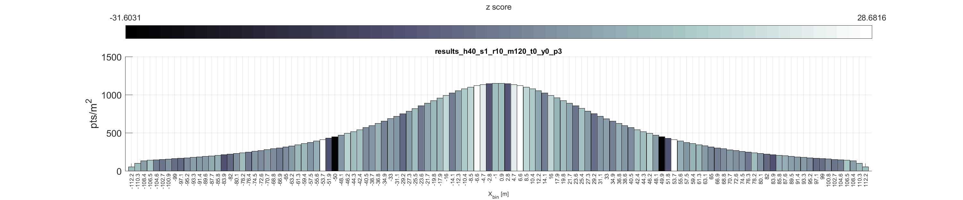


^{[3]} Results
Nearest neighbor index (top) and scan pattern (bottom) at flying height of 40 m and forward speeds of 2 m/s (left) and 1 m/s (right). Scan pattern exaggerated in y to show detail.

Slide 26



^{[4]} Results
Example of mission plan with overlapping flight lines. 30 m AGL, 4 m/s, max range 60 m, 50 m flight line spacing

